Slide 1
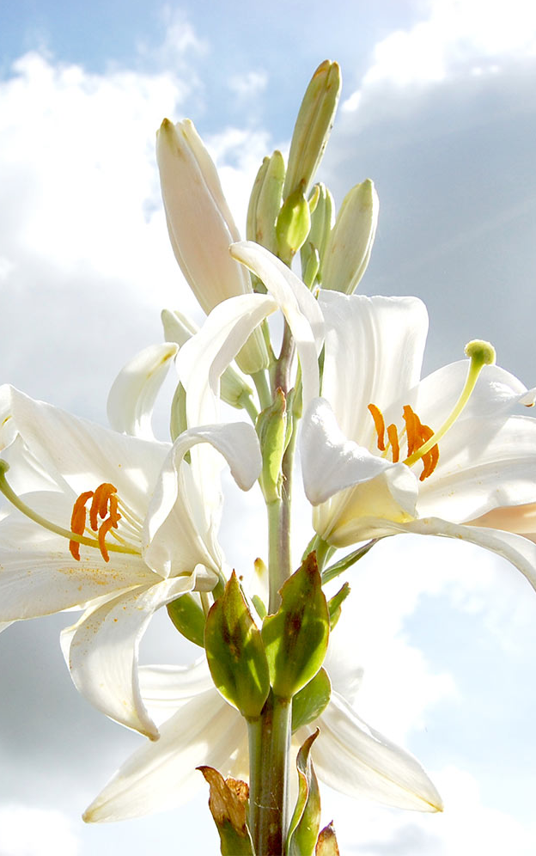
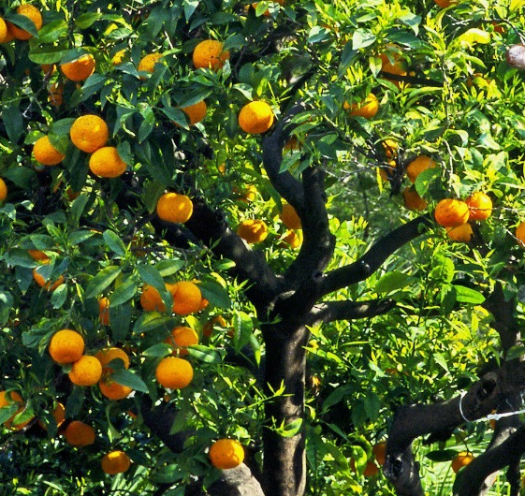
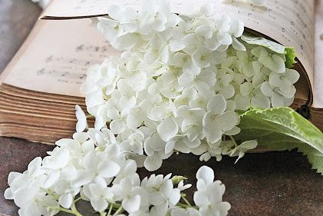
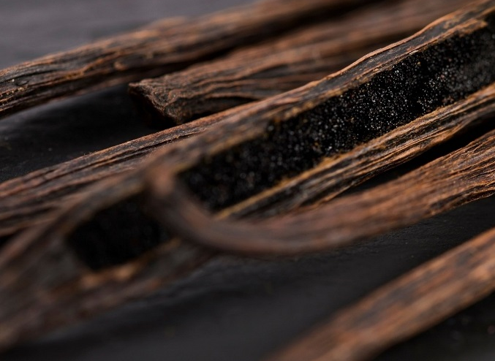
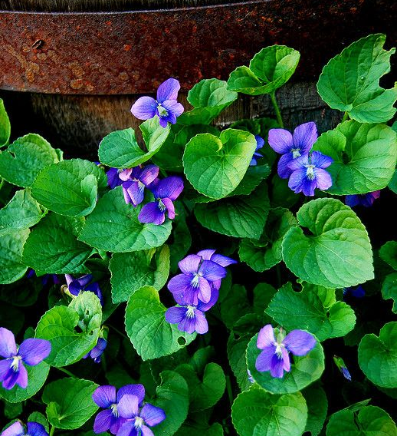
FEMININE
LYS
FLORAL
Top Notes
Petitgrain
Orange Blossom
Middle Notes
Lys – Jasmine – Violet Leaf
Base Notes
Vanilla

